Slide 1
WELCOME

Slide 2
History
Independent enquiry since 1988
Commissioned by HQIP - Clinical Outcome Review Programmes
  Medical and Surgical CORP
  Child Health CORP
Commissioned by the Health Foundation
  Prison healthcare

Slide 3
How NCEPOD works with other organisations doing similar work
Enquiries
Mortality reviews
National clinical audits
GIRFT
NICE
CQC

Slide 4
Coverage
England
Wales
Northern Ireland
Independent sector

Slide 5
NCEPOD supporting bodies
Royal College of Emergency Medicine
Association of Anaesthetists
Association of Surgeons
Royal College of Anaesthetists
Royal College of Radiologists
Royal College of Ophthalmologists
Royal College of Surgeons Eng
Faculty of Public Health Medicine of RCP
Lay Representatives
Royal College of Psychiatrists
Faculty of Intensive Care Medicine
Royal College of Pathologists
Royal College of Obstetricians & Gynaecologists
Royal College of Physicians
Royal College of General Practitioners
Royal College of Nursing
Royal College of Paediatrics and Child Health
Royal College of Surgeons Ed
Royal College of Physicians & Surgeons Glasgow
Faculty of Dental Surgery of RCS
Independent Healthcare Partners Network

Slide 6
Wider structure
NCEPOD
Steering Group
Chief
Executive
Clinical
Co-ordinators
Study Advisory
Group
Case
Reviewers
Clinical
Researchers
Local Reporters and Ambassadors
Researchers/IT
Admin Team
Scientific
Advice
NCEPOD
Trustees
Lay
Representatives
All clinicians
HQIP
CORP IAG

Slide 7
Structure
15 Non-clinical staff
10 Clinical Co-ordinators
550+ Local Reporters
100+ Ambassadors

Slide 8
The role of the Local Reporter
History and evolution of the role
What the role involves
Handing on the baton

Slide 9

What are your biggest challenges?

Slide 10
The role of the Ambassador
History of the role
What the role involves
Support provided

Slide 11
Participation
Hospital participation is encouraged by
  NCAPOP
  NHS Quality Accounts
Hospital participation supports
  The NHS Long Term Plan
  A Healthier Wales: Long Term Plan for Health and Social Care
Clinician participation is encouraged by
  GMC - Good Medical Practice/Good Surgical Practice
  CPD

Slide 12
What do you do to encourage participation?

Slide 13
Confidentiality
It applies to the patient data
It applies to all healthcare professionals and the hospital
Section 251
DPA 1998/GDPR
Ethics
National Data Opt-Out

Slide 14
Method

Slide 15
Topic selection
Call for topics made to all our stakeholders
1st review made by NCEPOD Co-ordinators
2nd review made by NCEPOD Steering Group
Top four topics are taken to HQIP

Slide 16
Study design
Topic selection
Study Advisory Group
  Identify study themes
  Determine what questions need to be asked
  Contents of the questionnaires or case reviewer assessment form
Patient focus groups
Questionnaires developed
Testing of data collection

Slide 17
Running the main study
Topic selection
Organisational questionnaire
Clinical questionnaires
Cases are identified to us
Extracts of the case notes requested
Anonymous online surveys
  patients/ carers
  clinicians

Slide 18
Who are NCEPOD case reviewers?
Active working clinicians, nurses and other relevant healthcare professionals
Review other clinicians’ work
Assess cases
Common themes
Recommendations

Slide 19
Case reviewers
Multidisciplinary group
Specialties
Hospitals
Recruitment *

Slide 20
Case reviewer meetings
Case reviewer training day
8-10 reviewers
5 cases - case notes and questionnaire
Assessment form

Slide 21
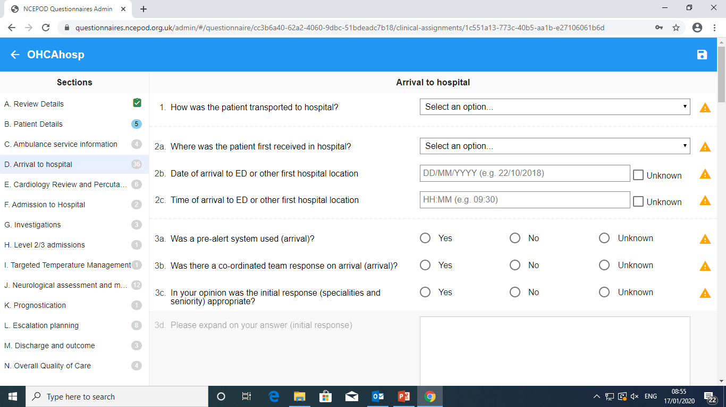
Case reviewer assessment form

Slide 22
Case reviewer meetings
Assessing quality of care
Overall quality of care assessed on a 5 point scale
Cause for concern
  Group discussion
  Chief Executive & Lead Co-ordinator
  Letter to Medical Director
Notes:
Good Practice
Room for Improvement (Clinical)
Room for Improvement (Organisational)
Room for Improvement (Clinical & organisational factors)
Less than Satisfactory

Slide 23
Case notes and the online system

Slide 24
Returning case notes
We can receive digital case notes through:
Password protected Zip files
Secure Egress link
Microsoft SharePoint
All shared to ncepod@nhs.net with passwords phoned through to the office (020 7251 9060)
Paper Copies:
FREEPOST envelopes can provided (max of 1kg)
Recorded delivery recommended over 1kg

Slide 25
Case notes when at NCEPOD
- On arrival at NCEPOD case notes are logged on our database and the online system
- Notes are checked and patient data is anonymised
  - All the case notes are stored in locked cupboards
  - Case reviewers don’t have access to patient identifiable information
  - Case notes are securely destroyed three months after the Report is published

Slide 26
NCEPOD Online system
The Local Reporter account:
- Managing the assignment and completion of questionnaires
- Record the sending of case notes/audit trail
- Clinician questionnaires
  Assign questionnaires to relevant clinicians
  Monitor progress
- Organisational questionnaires
  Input data and/or invite others to input information
  Monitor progress
  Submit completed questionnaire

Slide 27
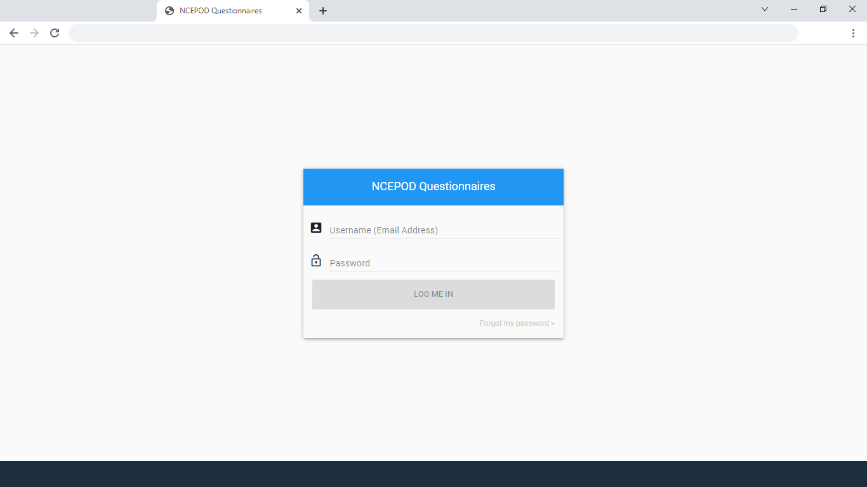

Slide 28
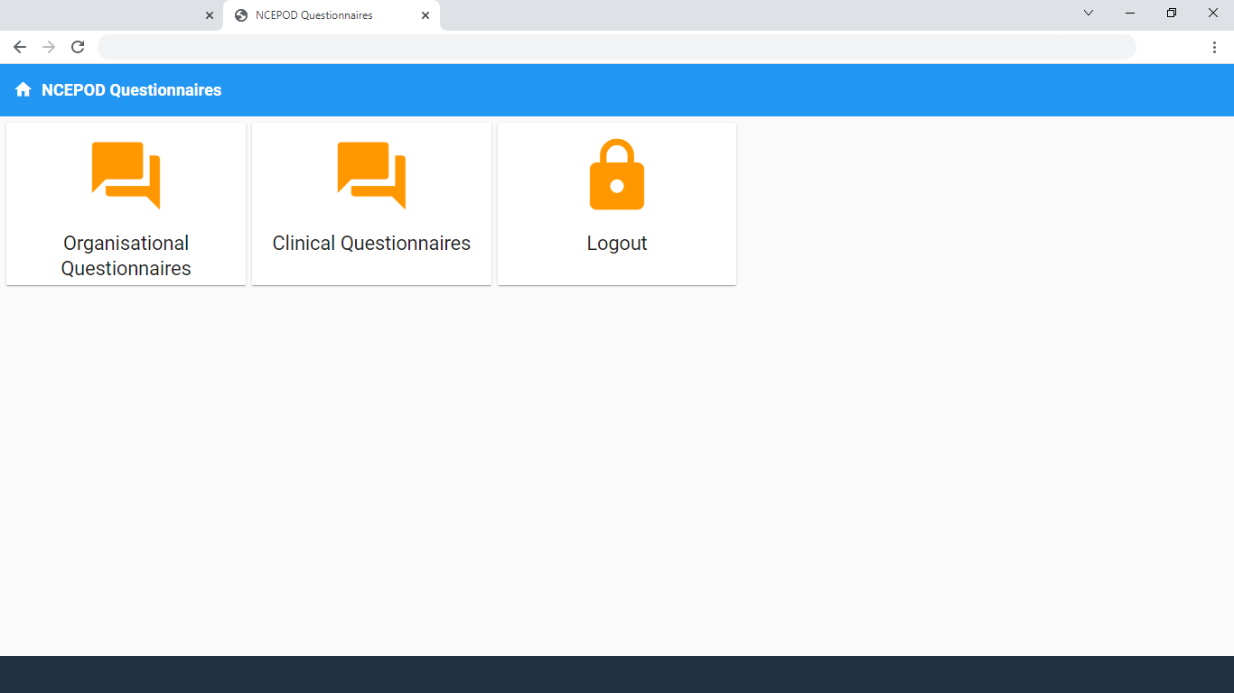

Slide 29
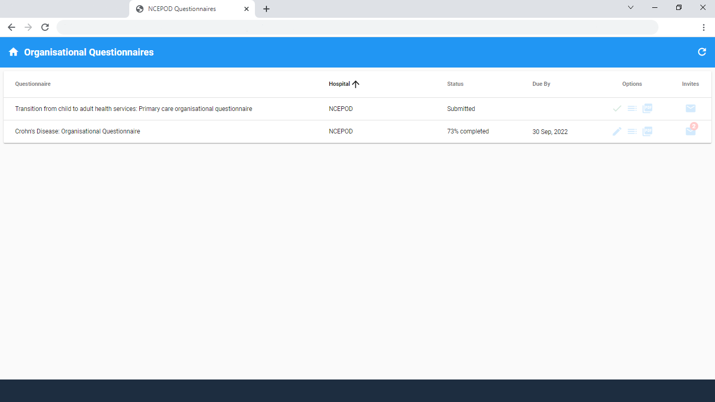

Slide 30
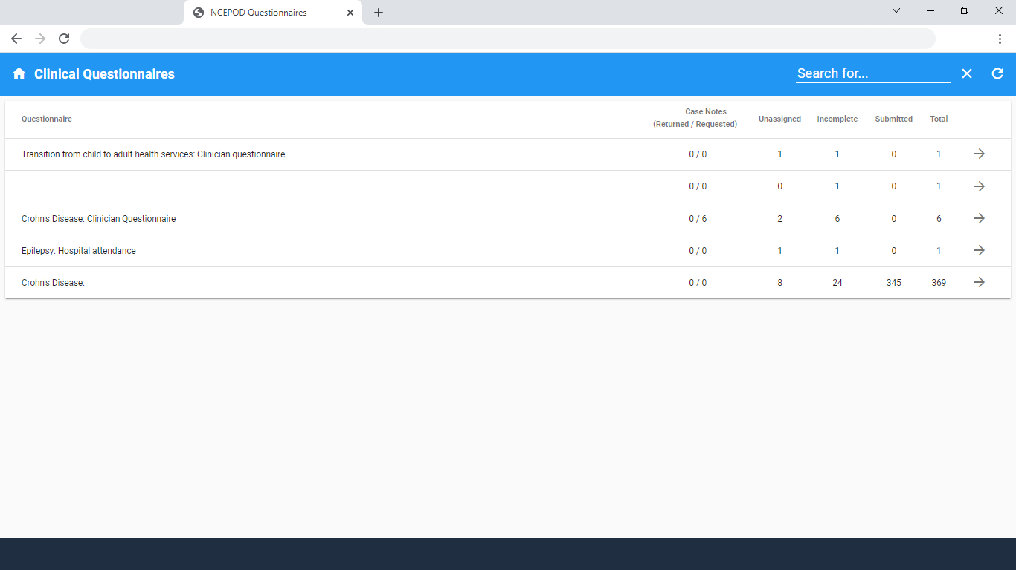

Slide 31
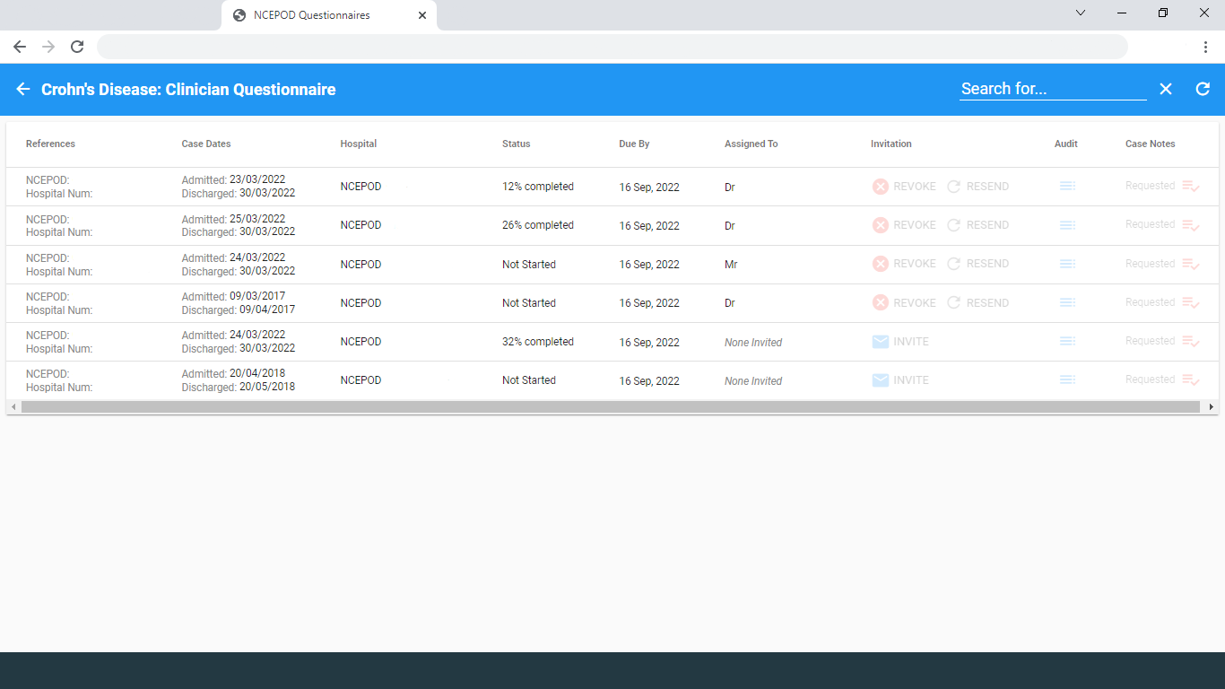

Slide 32
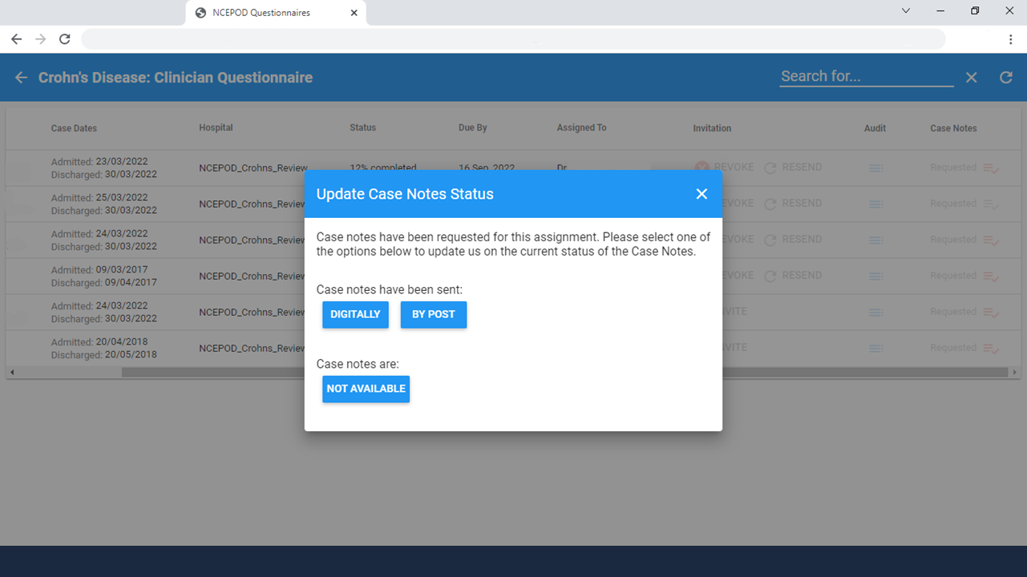

Slide 33
Study outputs and impact

Slide 34


Slide 35

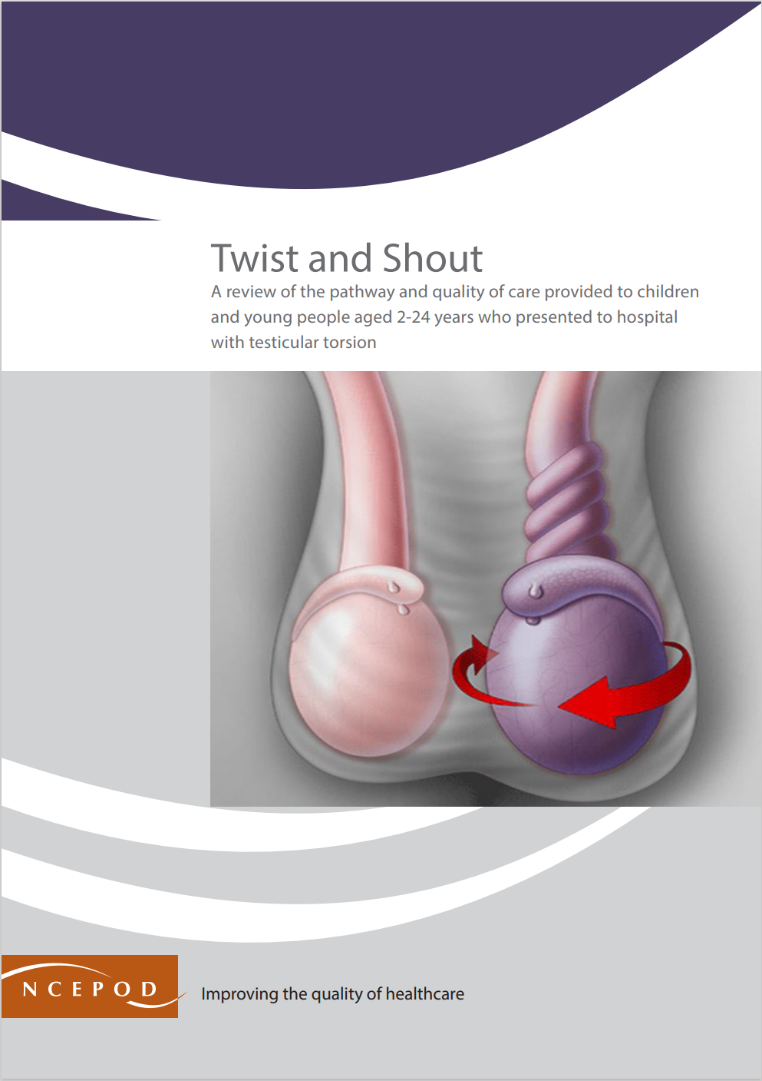
Reports

Slide 36


















Reports

Slide 37

Which reports have you found most useful and why?

Slide 38
Stakeholder meetings
12 – 18 months post publication
Local and national impact
  Recommendation check lists, QI projects
  Nice guidance
Upcoming meetings
  Transition (July 11th)
  Epilepsy
  Crohn’s disease
Notes:
Good Practice
Room for Improvement (Clinical)
Room for Improvement (Organisational)
Room for Improvement (Clinical & organisational factors)
Less than Satisfactory

Slide 39
Current studies

Slide 40
Juvenile Idiopathic Arthritis
Data collection closes 14th June
Child and young person/parent carer surveys still open!
Report writing in progress

Slide 41
Emergency paediatric surgery
Despite improvements in healthcare provided to children and young people (CYP), there are still several challenges faced by high priority surgical CYP
  The organisation of non-specialist and specialist services
  Access to timely intervention
  The efficiency of pathways to intervention
  Appropriate specialty availability
  Equitable access to emergency care

Slide 42
Emergency paediatric surgery
Aim
  To identify good practice and remediable factors in the delivery of care provided to children and young people (CYP) (0-18th birthday) undergoing emergency (non-elective) procedures under anaesthetic or sedation.
Objectives
  Delays in arrival in theatre

Slide 43
Emergency paediatric surgery
Participating providers of healthcare
  All hospital providers where patients might undergo emergency (non-elective) procedures will be asked to participate in the study.
Inclusion criteria
  CYP aged 0 to 18th birthday
  Undergoing an emergency (non-elective) procedure
  Under anaesthetic or sedation
  Patients should be identified for inclusion from hospital theatre or patient administration systems.

Slide 44
Emergency paediatric surgery
Data collection
Two retrospective time frames
  Monday 17th June 00:00 – Sunday 30th June 23:59 2024 (TIMEFRAME 1)
  Monday 12th February 00:00 – Sunday 25th February 23:59 2024 (TIMEFRAME 2)
Spreadsheet deadlines
  June data: Friday 12th July
  February data: Friday 9th August

Slide 45
Emergency paediatric surgery
Data collection
On the day survey
  Open Monday 17th June 00:00 – Sunday 30th June 23:59 2024
  Will not be linked to quality accounts.
  Should be completed as close to the time of the procedure as possible, but it does not have to be completed during/immediately following surgery.
  We recognise that a survey will not be completed for every patient
  Can be completed by any member of the theatre team providing care to the patient – more than one member of the team can complete a survey on the same patient if they want to.
  The patient identification spreadsheets will still be the main source for identifying patients for inclusion in the study.
  Data opt out – online survey or PDF or Word version

Slide 46
Emergency paediatric surgery
Questionnaires
  Surgical questionnaire
  Anaesthetic questionnaire
  Transfer questionnaire
  Organisational questionnaire
  Clinician survey (separate to the on the day survey)
Case notes
Case note reviewers
  Deadline for applications: 6th July

Slide 47
STUDY | June | July | August | September | Data Deadlines
Rehabilitation following Critical Care | Patient identifier Spreadsheet B: DISSEMINATED Clinician questionnaire: DISSEMINATED Case note requests: DISSEMINATED | Patient Identifier Spreadsheet B: CLOSED | Organisational questionnaire: TO BE DISSEMINATED | Clinician and organisational data collection: OPEN | Patient identifier spreadsheet A: Organisational questionnaire: Clinician questionnaire: Case note extracts: | CLOSED To be set 1st July 2024 1st July 2024
Juvenile Idiopathic Arthritis | Patient identifier spreadsheet collection CLOSED Clinician and organisational data collection OPEN Case note data collection OPEN | DATA COLLECTION CLOSED | DATA COLLECTION CLOSED | DATA COLLECTION CLOSED | Patient identifier spreadsheet: Organisational questionnaire: Clinician questionnaire: Case note extracts: | CLOSED 14th June 2024 14th June 2024 CLOSED
Blood Sodium | Patient identifier spreadsheet: DISSEMINATED | Clinician and organisational questionnaires: DISSEMINATED Case note requests: DISSEMINATED | Clinician and organisational data collection: OPEN | Clinician and organisational data collection: OPEN | Patient identifier spreadsheet: Organisational questionnaire: Clinician questionnaire: Case note extracts: | 7th June 2024 To be set To be set To be set
Emergency Procedures in Children and Young People | Patient Identifier Spreadsheet disseminated On the day survey open (17th - 30th June) | Clinician questionnaire and case note requests disseminated (time frame 1) | Clinical data collection open | Clinician questionnaire and case note requests disseminated (time frame 2) | Patient identifier spreadsheet: Organisational questionnaire: Clinician questionnaire: Case note extracts: | TF1: 12th July 2024 TF2: 9th Aug 2024 To be set To be set To be set
Acute Limb Ischaemia | Study still in development | Study still in development | Study still in development | Study still in development | Patient identifier spreadsheet: Organisational questionnaire: Clinician questionnaire: Case note extracts: | To be set To be set To be set To be set
End of Life Care | DATA COLLECTION CLOSED | DATA COLLECTION CLOSED | DATA COLLECTION CLOSED | DATA COLLECTION CLOSED | Patient identifier spreadsheet: Organisational questionnaire: Clinician questionnaire: Case note extracts: | CLOSED CLOSED CLOSED CLOSED

Slide 48


